Slide 1
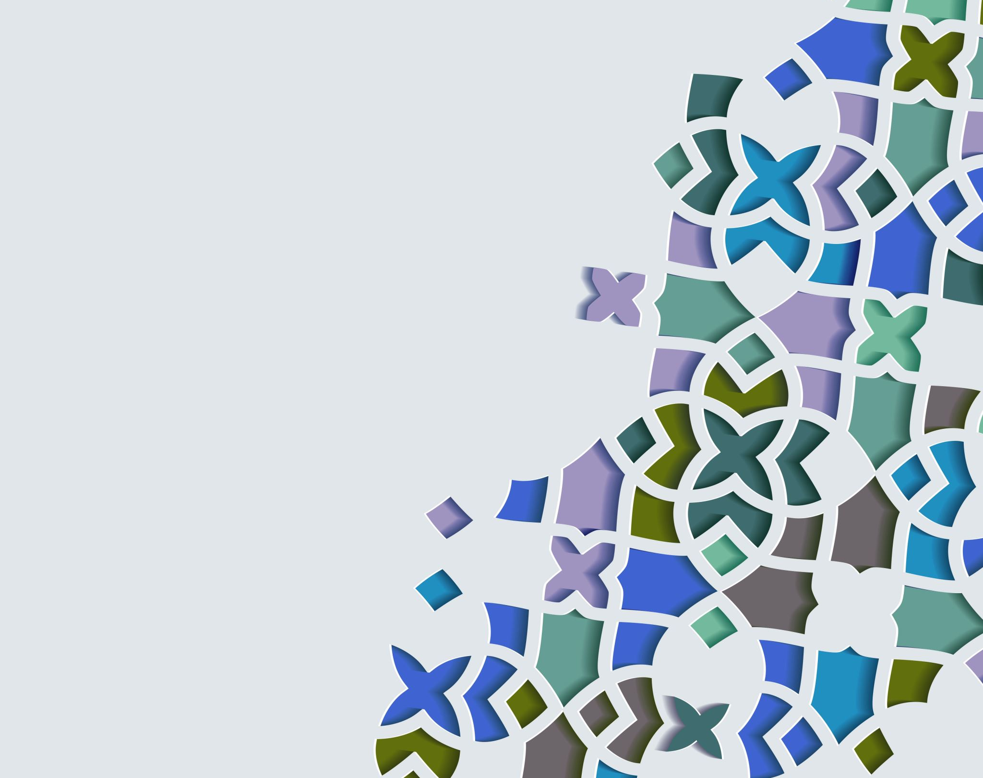
INFLUX TS DB OVERVIEW
NoSQL
Open-source
Go Language
OS: Linux/OS X
Schema-free

Slide 2
COMPETITIVE ADVANTAGES(INFLUXDB)
InfluxDB is available in all the popular languages and frameworks.
Easy-to-use quickstarts and documentation.
InfluxDB has the largest community of cloud and open-source developers for time series database solutions.
InfluxDB delivers visibility with real-time analytics so developers can quickly act on their data, such as identifying patterns, predicting future outcomes, and turning insights into action.

Slide 3

Implementation and supported programming languages(INFLUXDB)
Implementation language – Go lang.
Supported programming languages :
.Net, Clojure, Erlang, Go, Haskell, Java, JavaScript, JavaScript (Node.js), Lisp, Perl, PHP, Python, R, Ruby, Rust, Scala

Slide 4

APIs and other access methods(INFLUXDB)
HTTP API
JSON over UDP

Slide 5

QUEST TS DB OVERVIEW
SQL
Open-source
Java
OS: Linux, macOS, Windows
Schema-free (via InfluxDB Line Protocol)

Slide 6
COMPETITIVE ADVANTAGES (QUESTDB)
Real-time data ingestion and istant SQL queries for time series
High performance translates into reduced infrastructure costs
APIs for read and writes: REST API, HTTP, InfluxDB Line Protocol, PostgreSQL Wire, Grafana
Efficient disk storage
Small footprint: 3MB executable

Slide 7
Implementation and supported programming languages(QUESTDB)
Implementation language – Java.
Supported programming languages:
C/C++, Go, Java, JS, Node.Js, Python, Rust

Slide 8
APIs and other access methods(QUESTDB)
HTTP REST
InfluxDB Line Protocol (TCP/UDP)
JDBC

